Slide 1
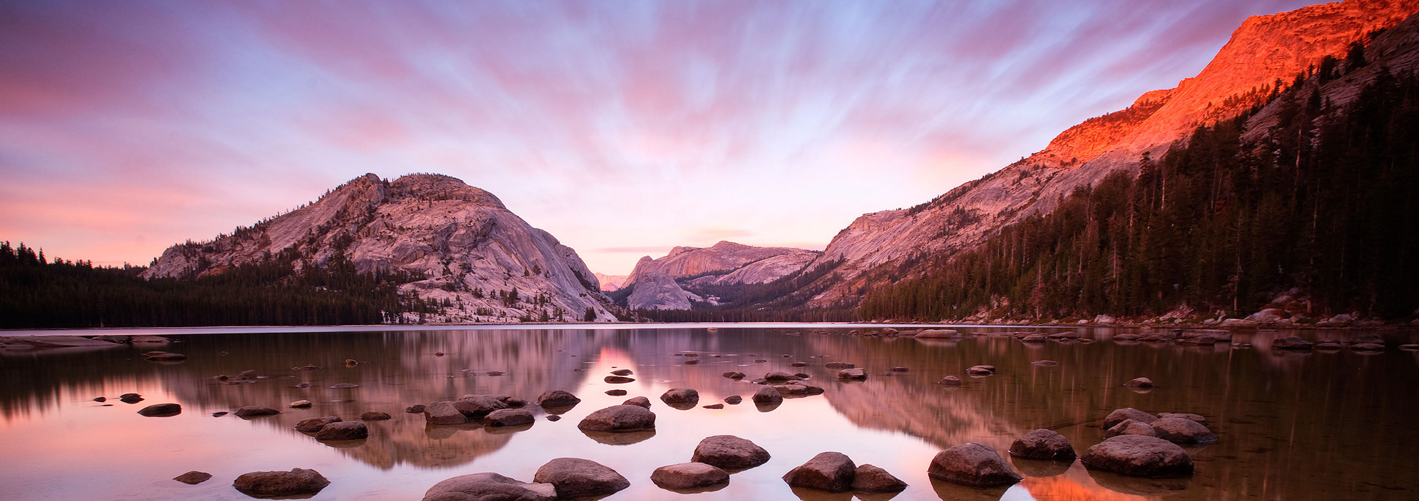
Like a Watered Garden

Slide 2
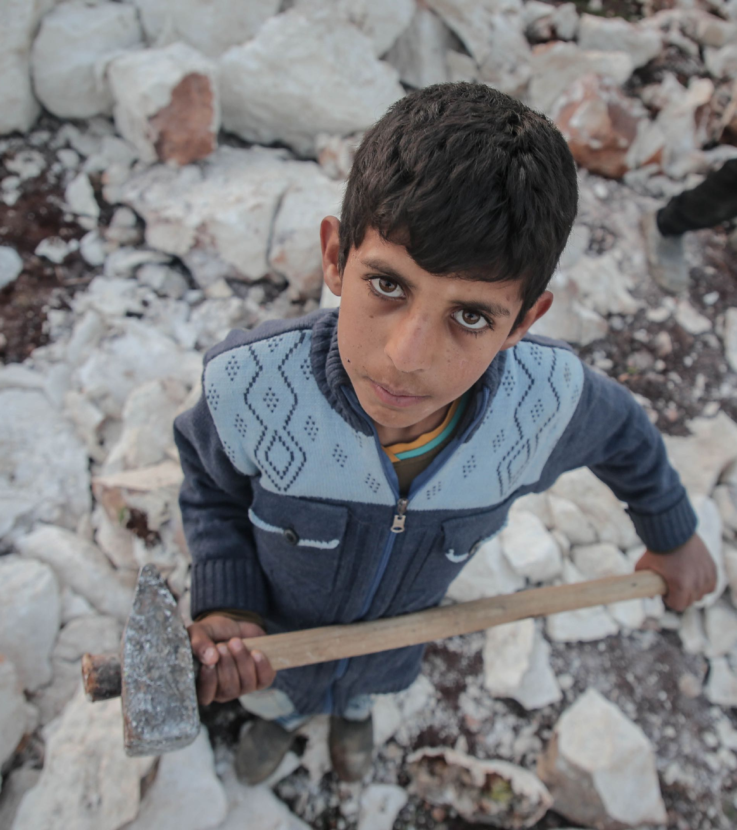
Selfish hands have trapped the poor
Bring them liberty

Slide 3
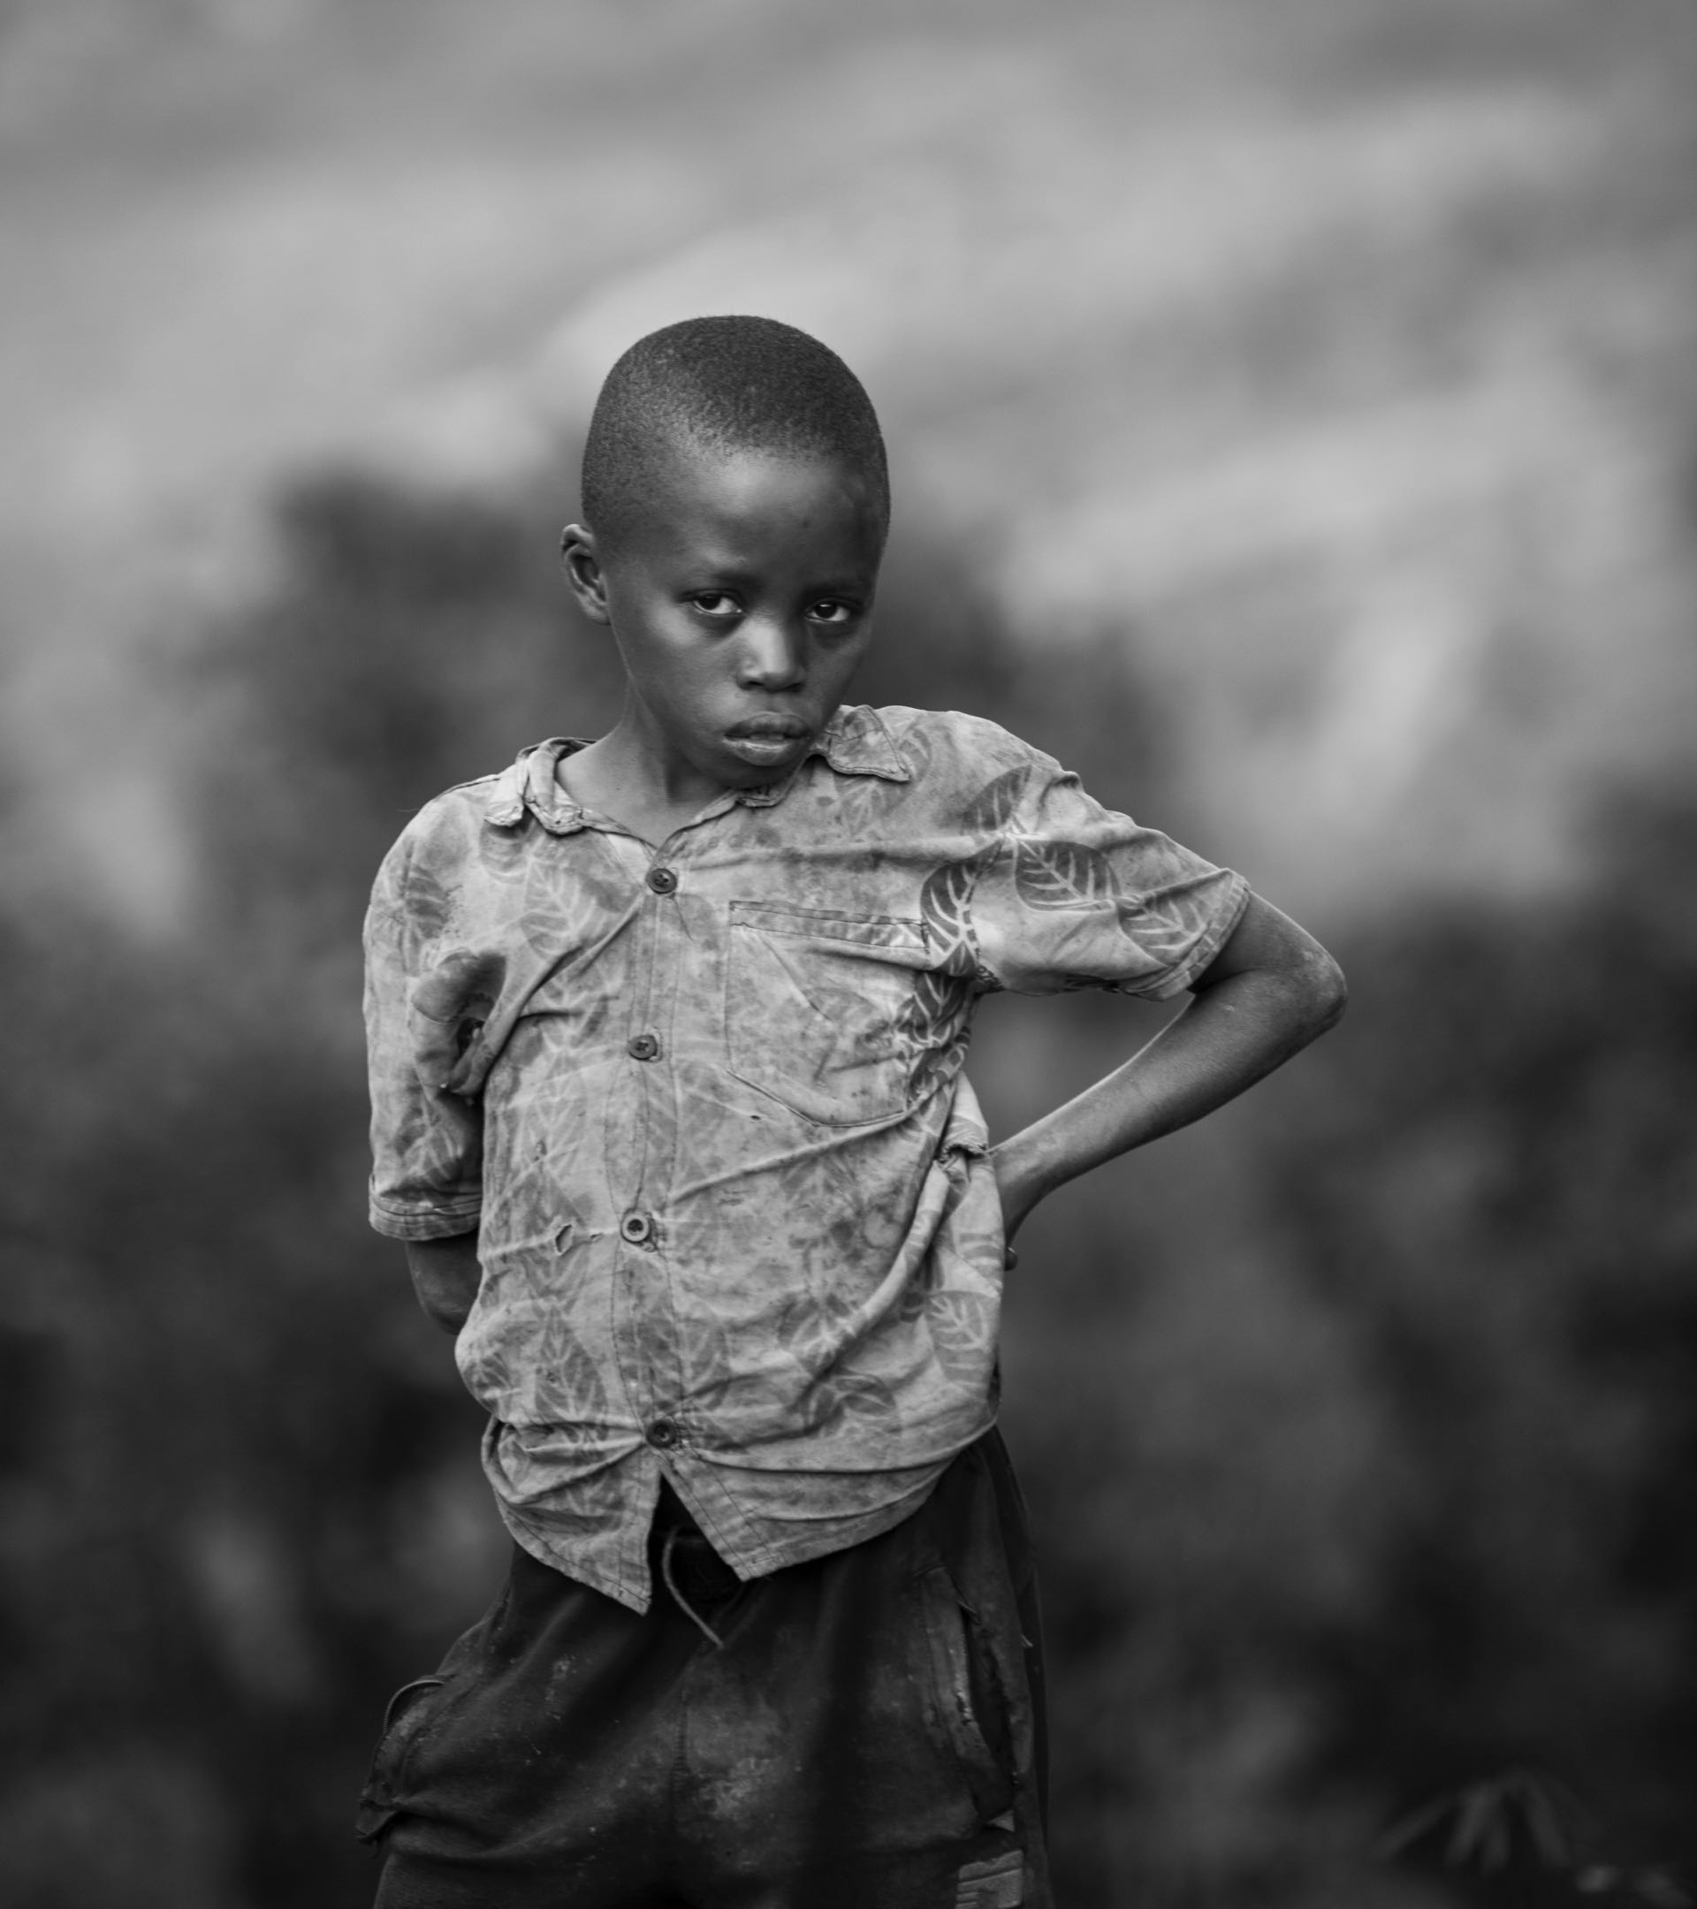
Child soldiers, prostitutes
Set the captives free

Slide 4
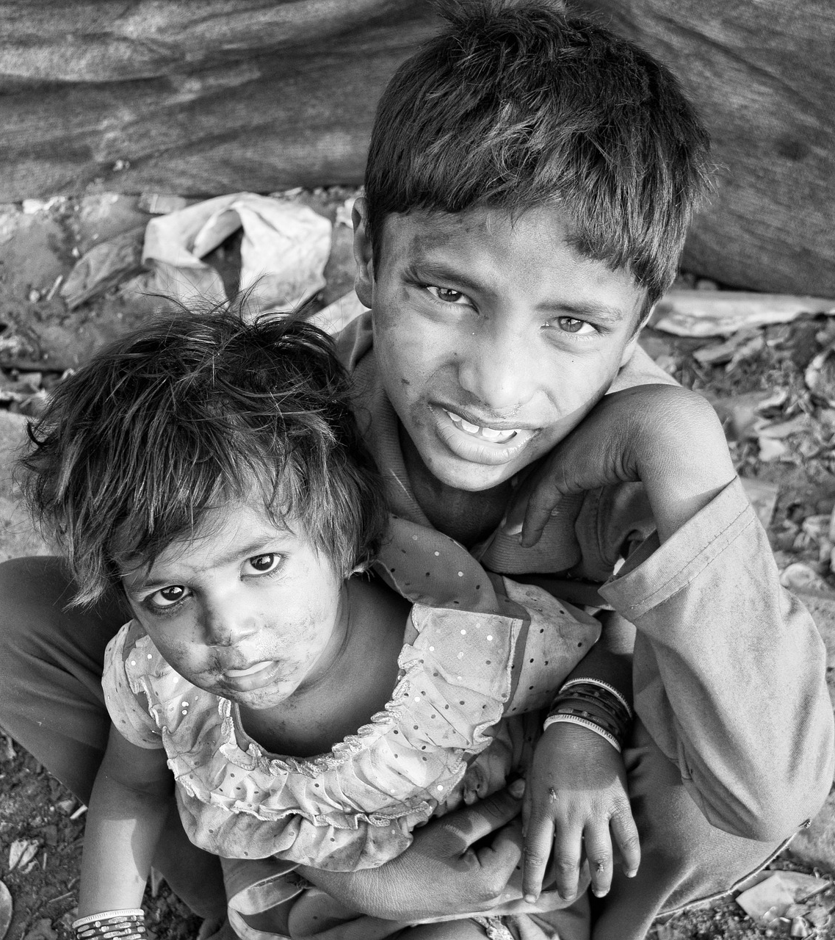
Widows starving, orphans cold
Share your clothes and bread

Slide 5
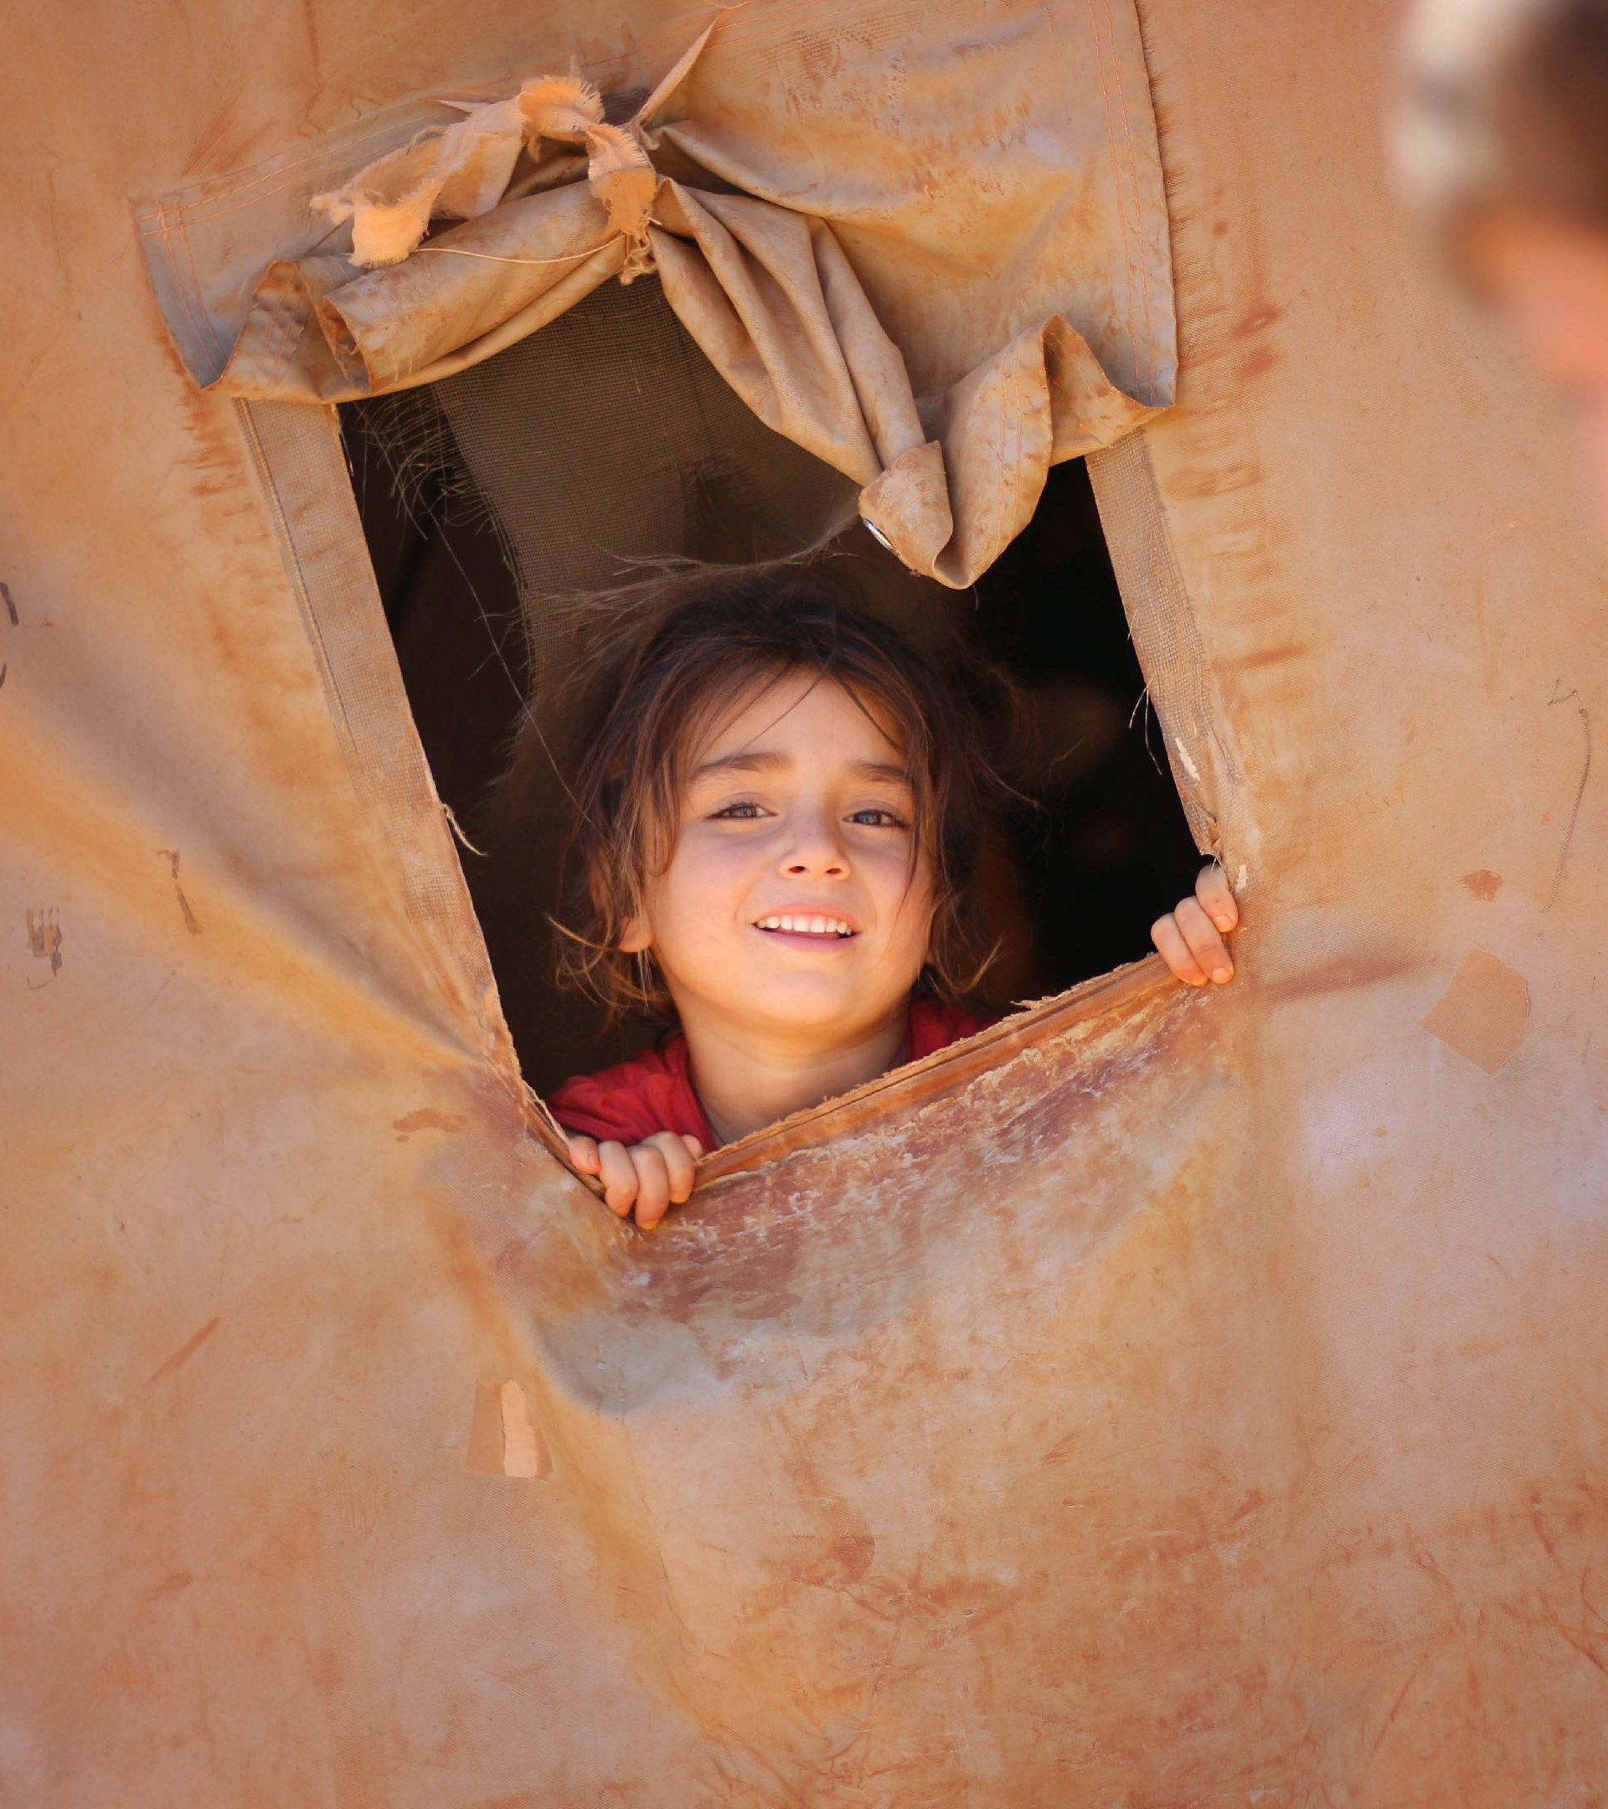
Lonely, cast-out refugees
Rest them on your bed

Slide 6
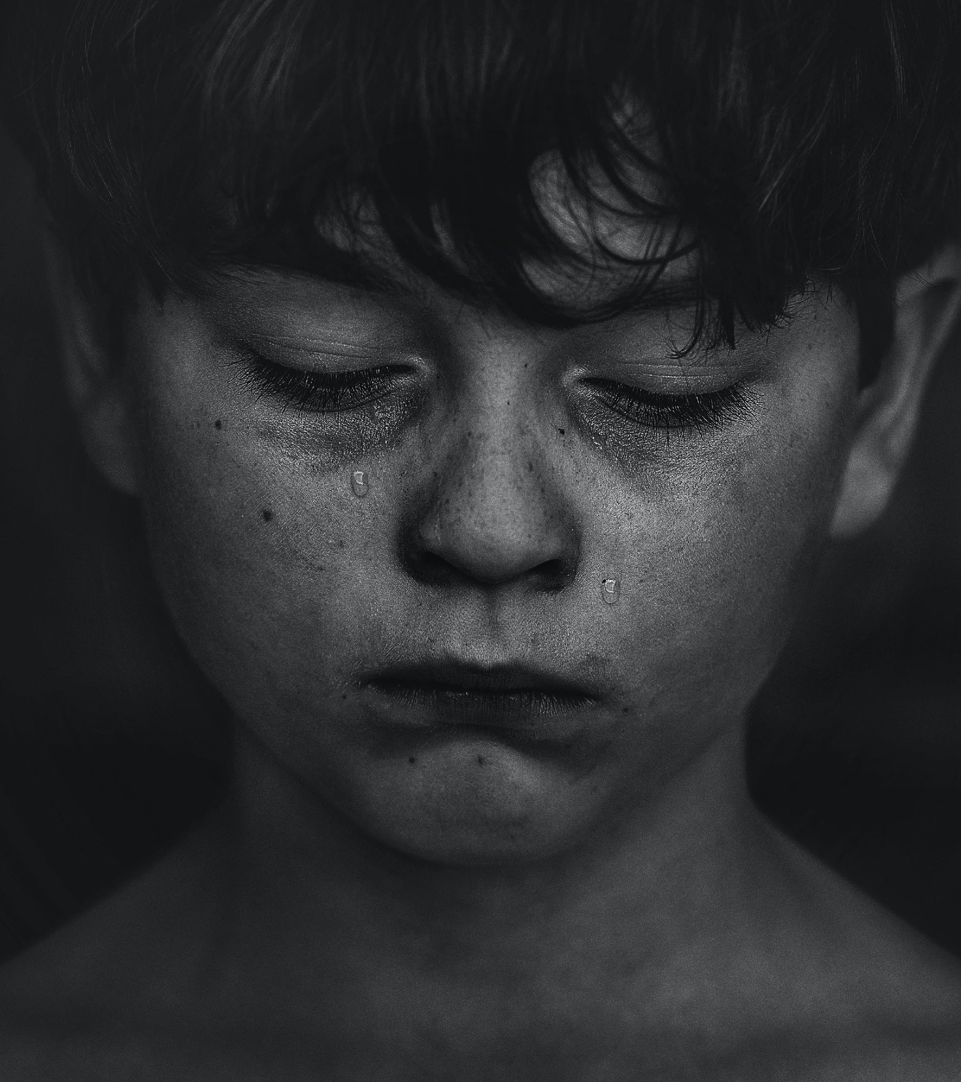
Broken-hearted, beaten down
Comfort, catch their tears

Slide 7

Abused, betrayed, and shaken-up
Gently calm their fears

Slide 8
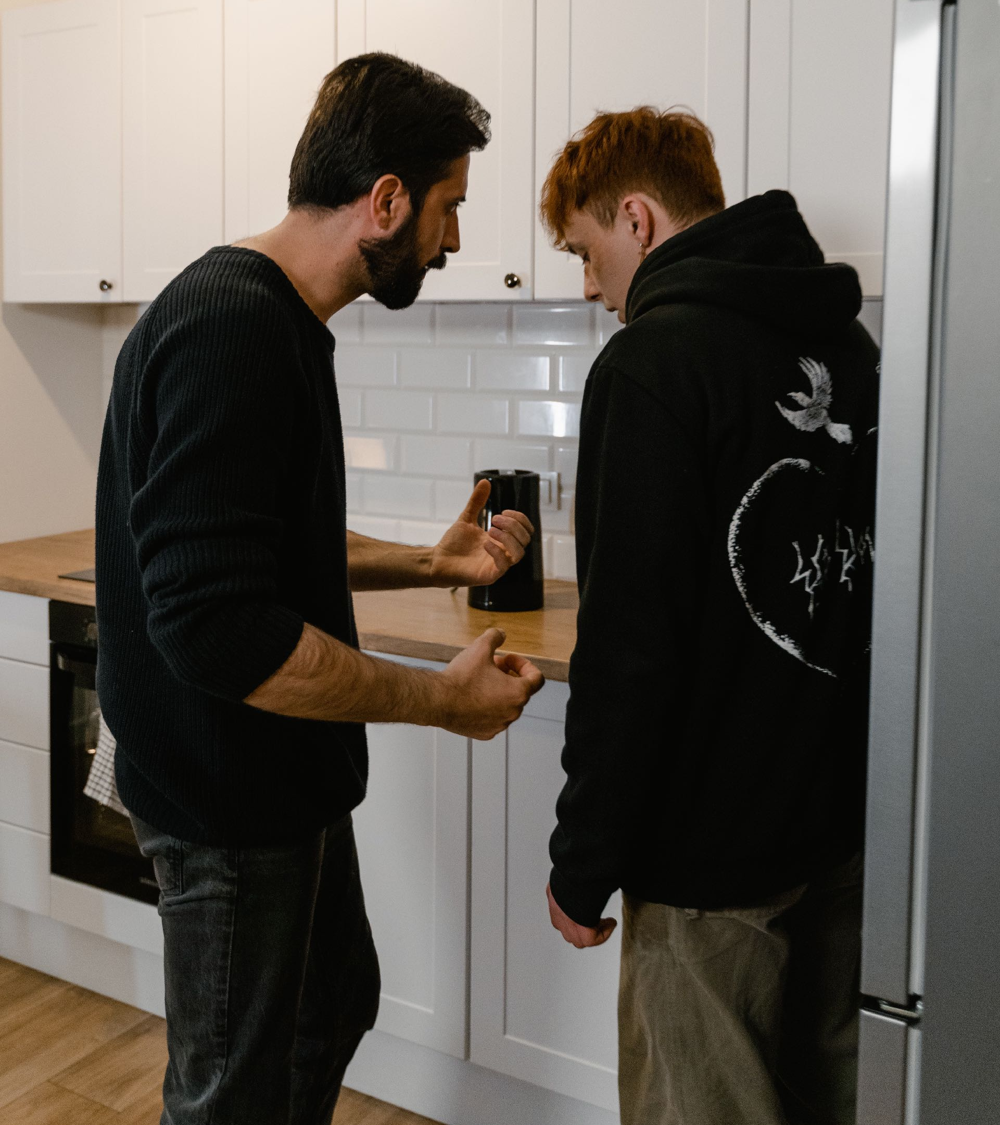
Stop your censure, cease to curse
Strife and fighting cease

Slide 9
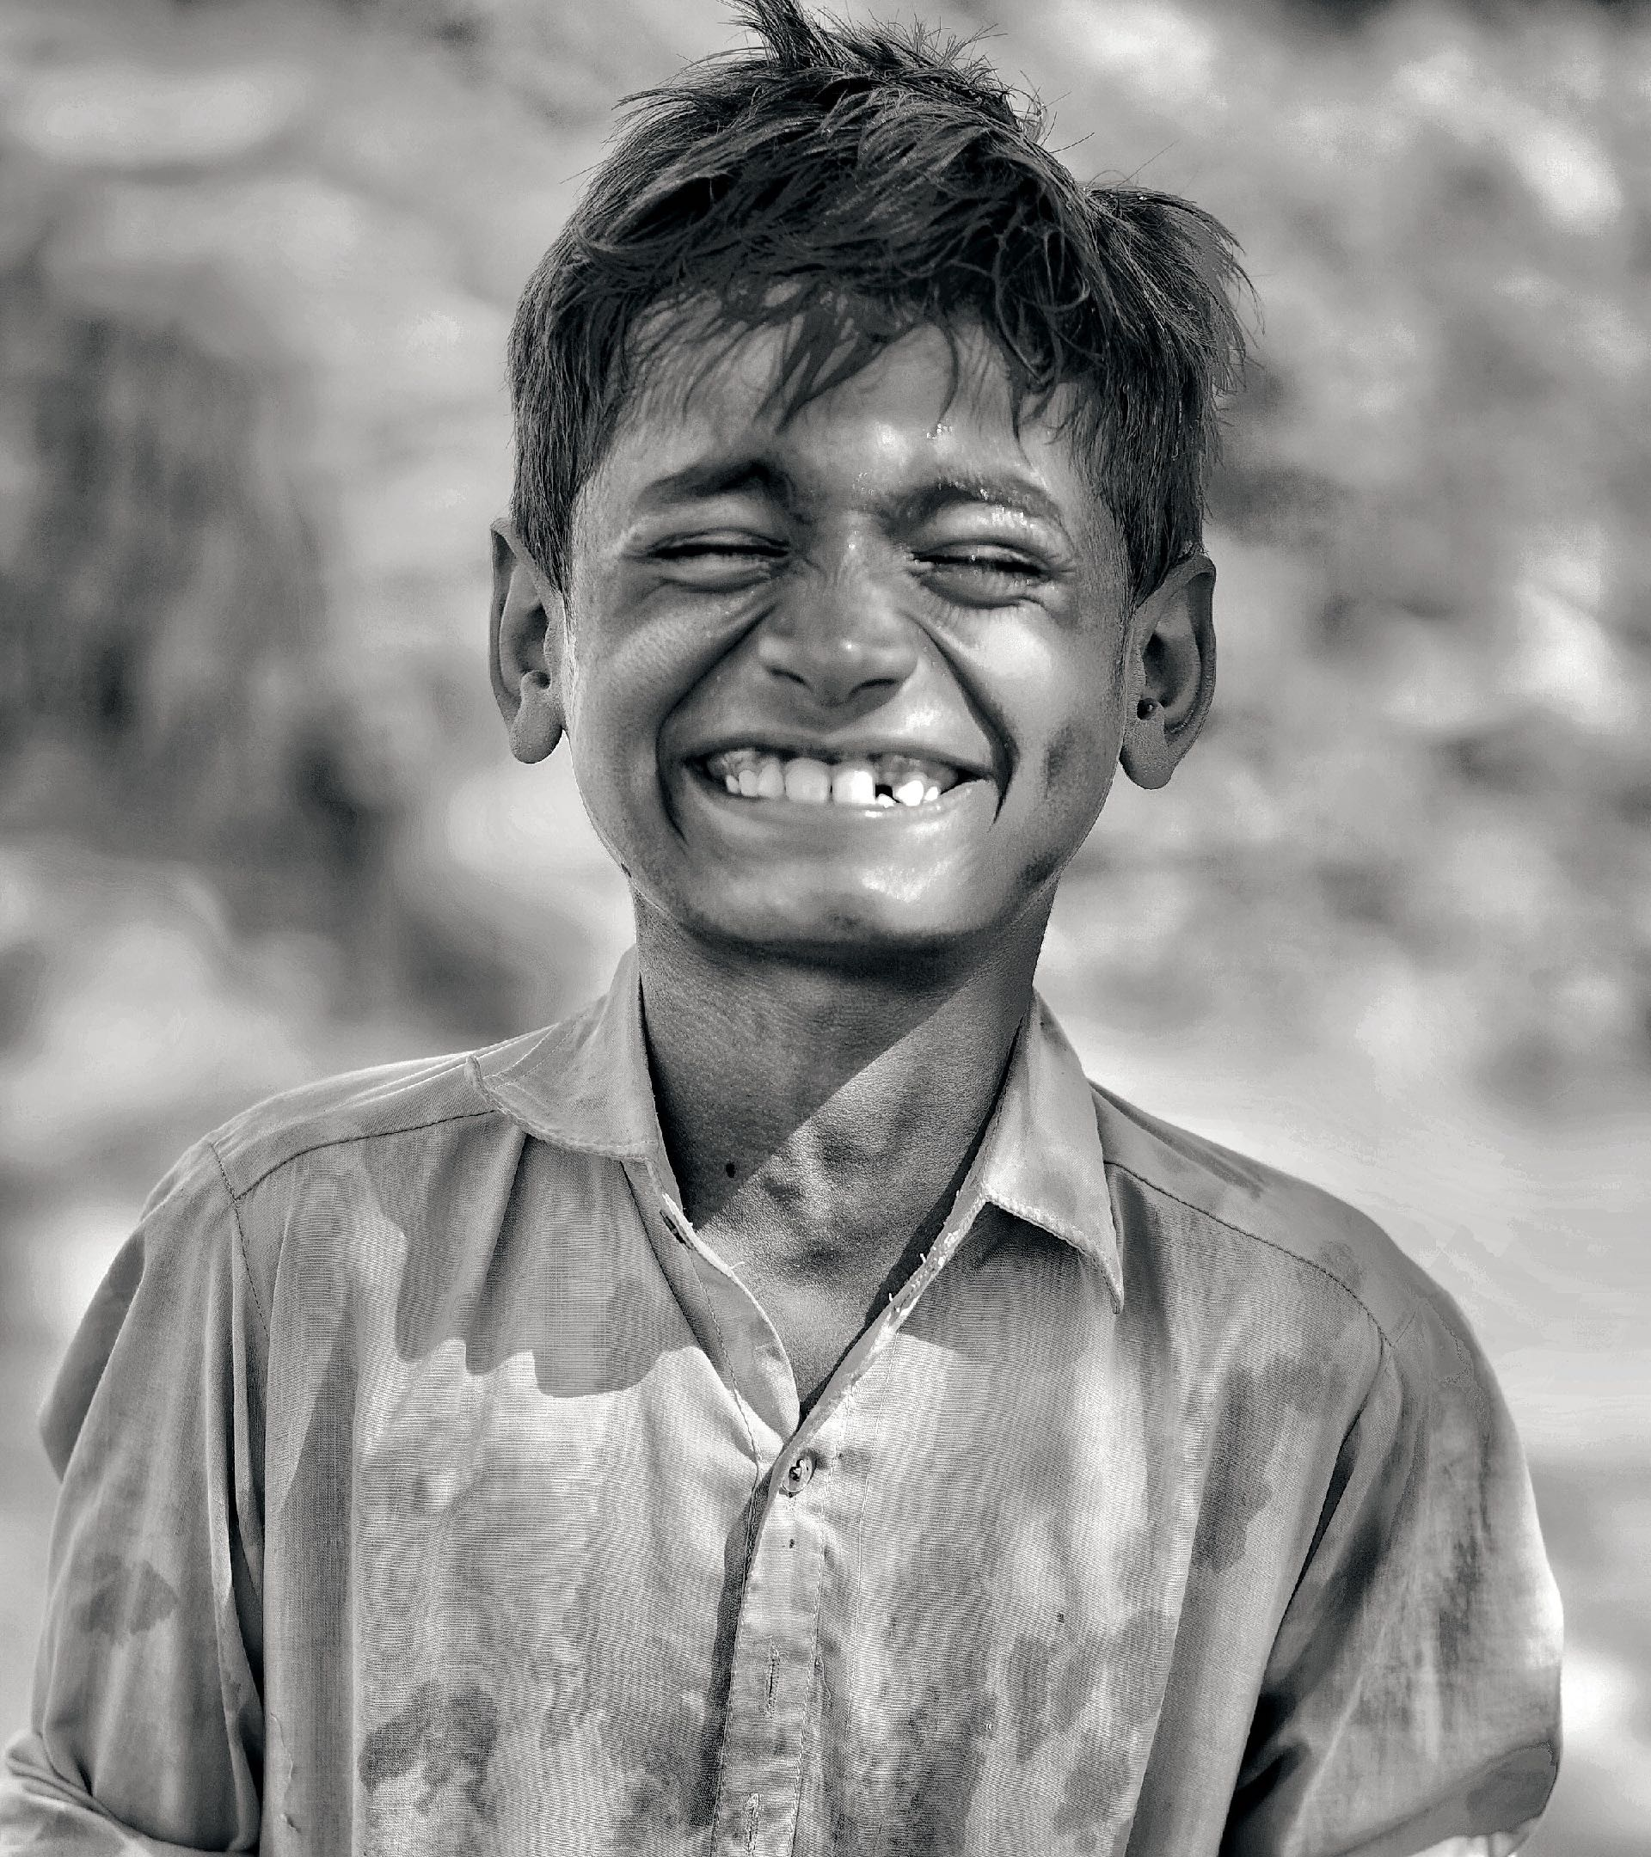
Let your paths be right and just
And your love bring peace

Slide 10
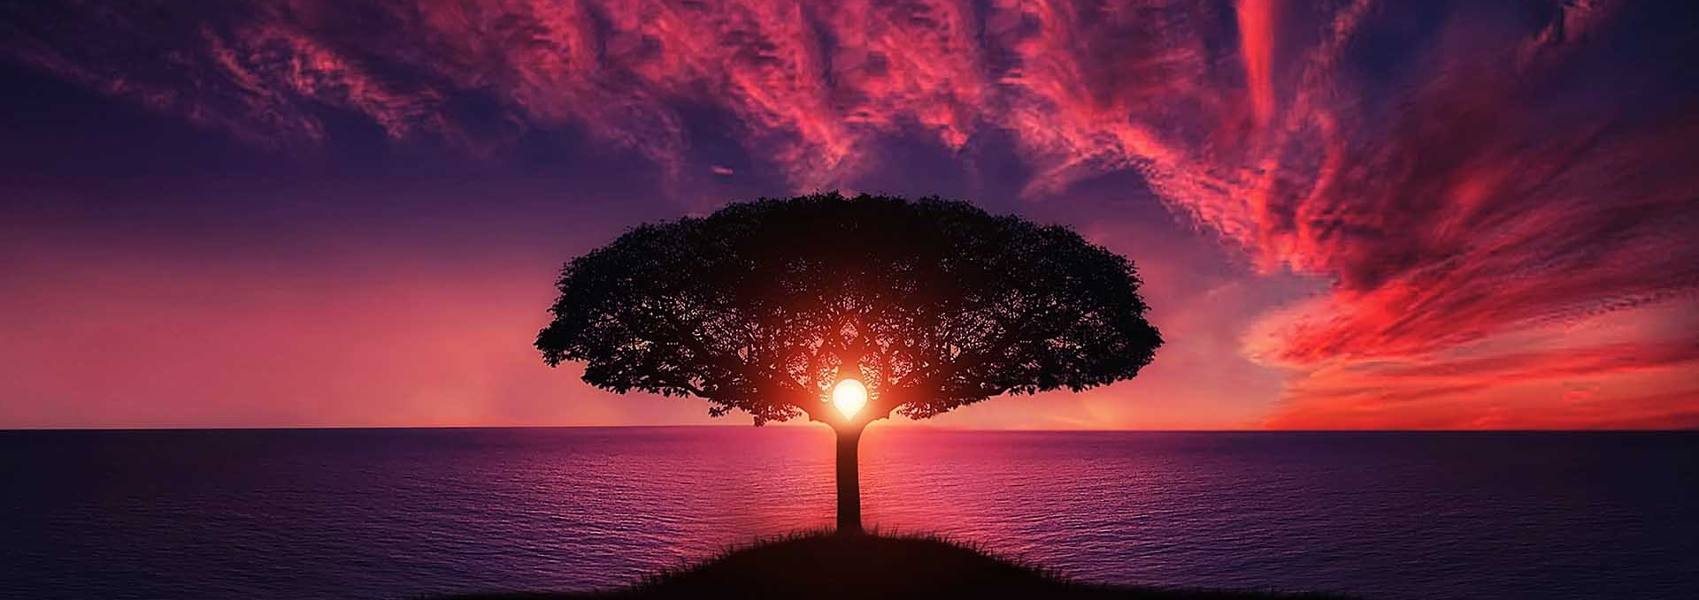
The light is shining
The darkness flees

Slide 11

Give God the glory
’Til all can see

Slide 12
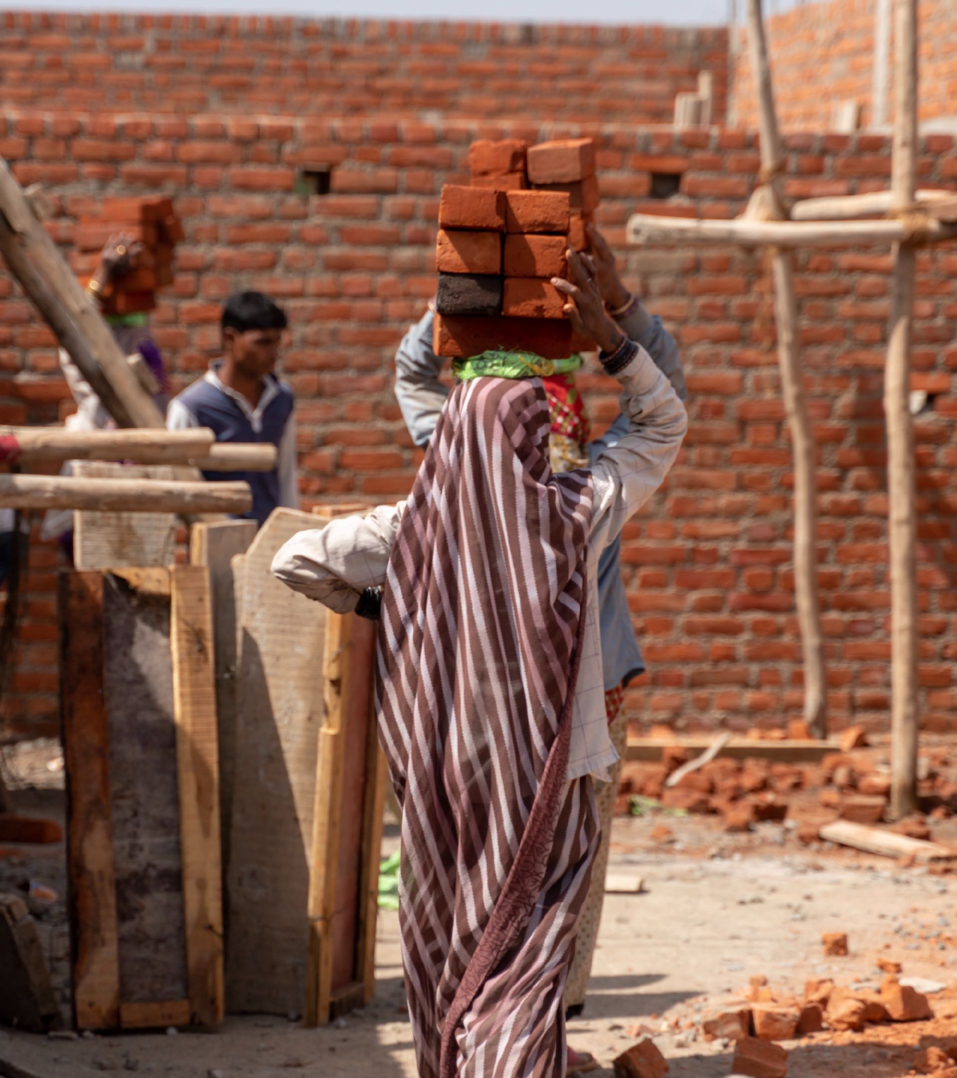
Walls of truth are broken down
Raise them piece by piece

Slide 13

There is refuge in God’s law
Come repair the breach

Slide 14
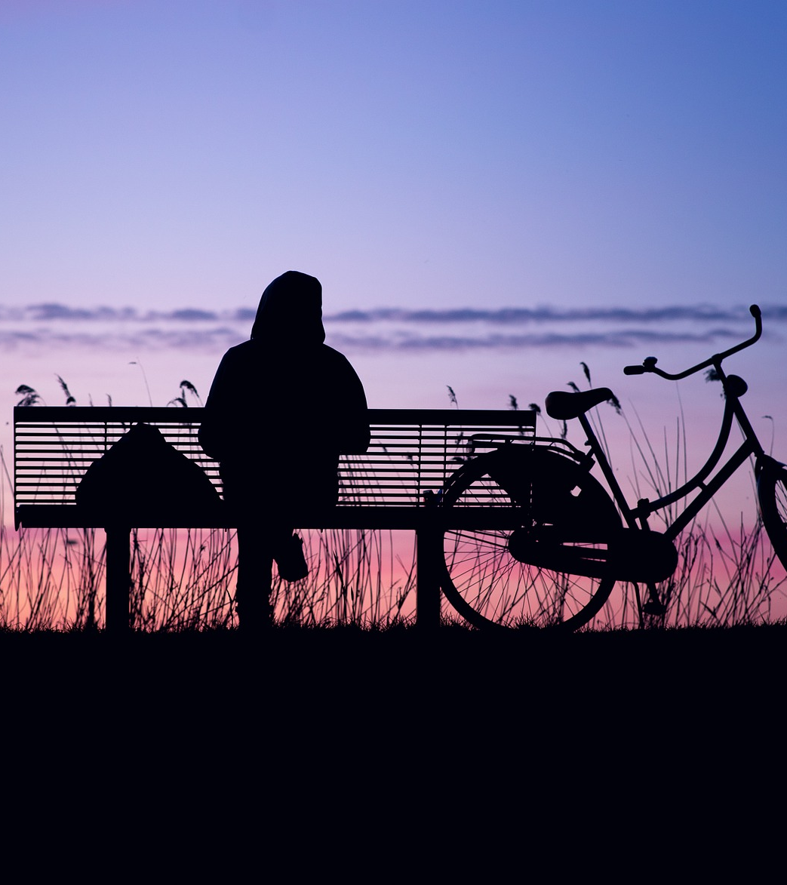
In the Sabbath take delight
Cease your selfish ways

Slide 15

Honor God who gave you life
Give Him all your days

Slide 16
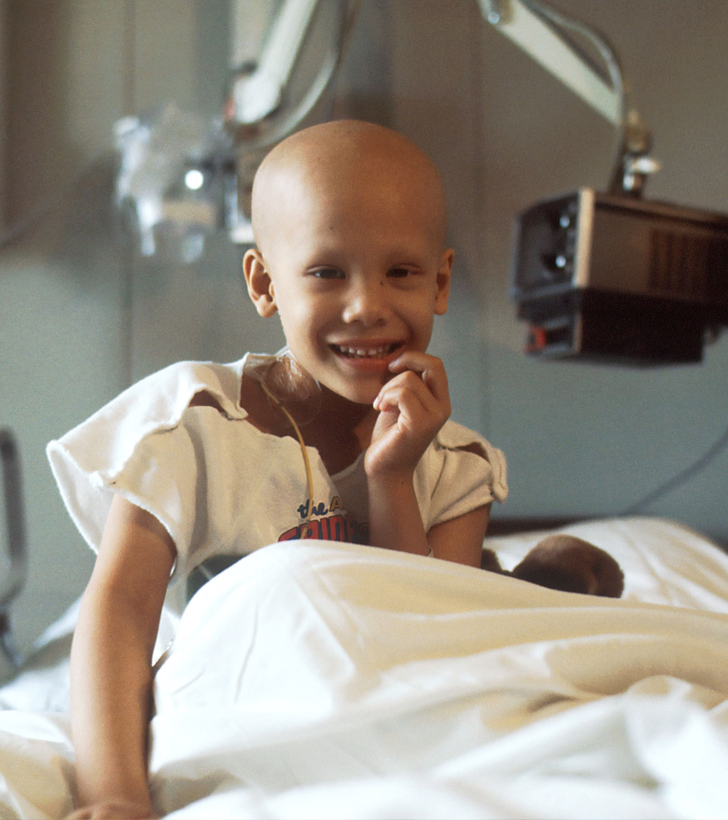
Then your darkness will be light
And your sickness healed

Slide 17
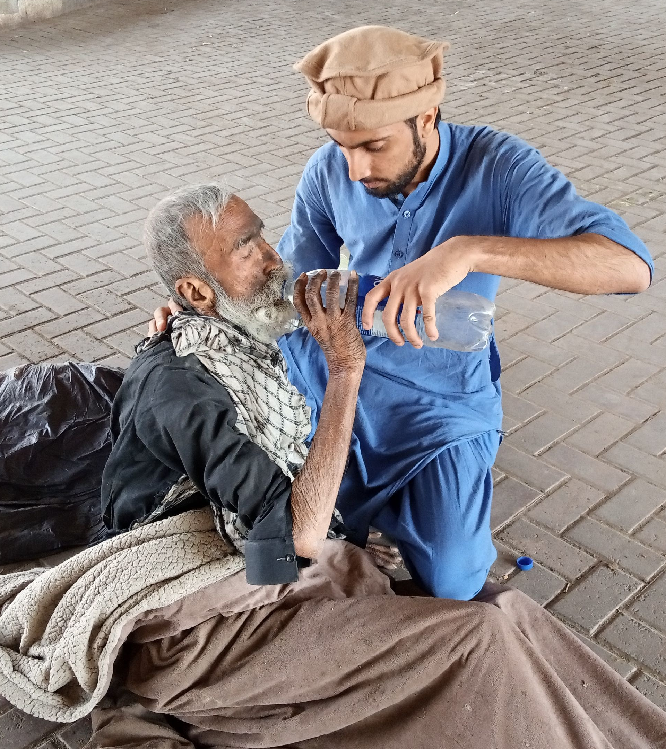
Righteousness will lead the way
Glory, be your shield

Slide 18
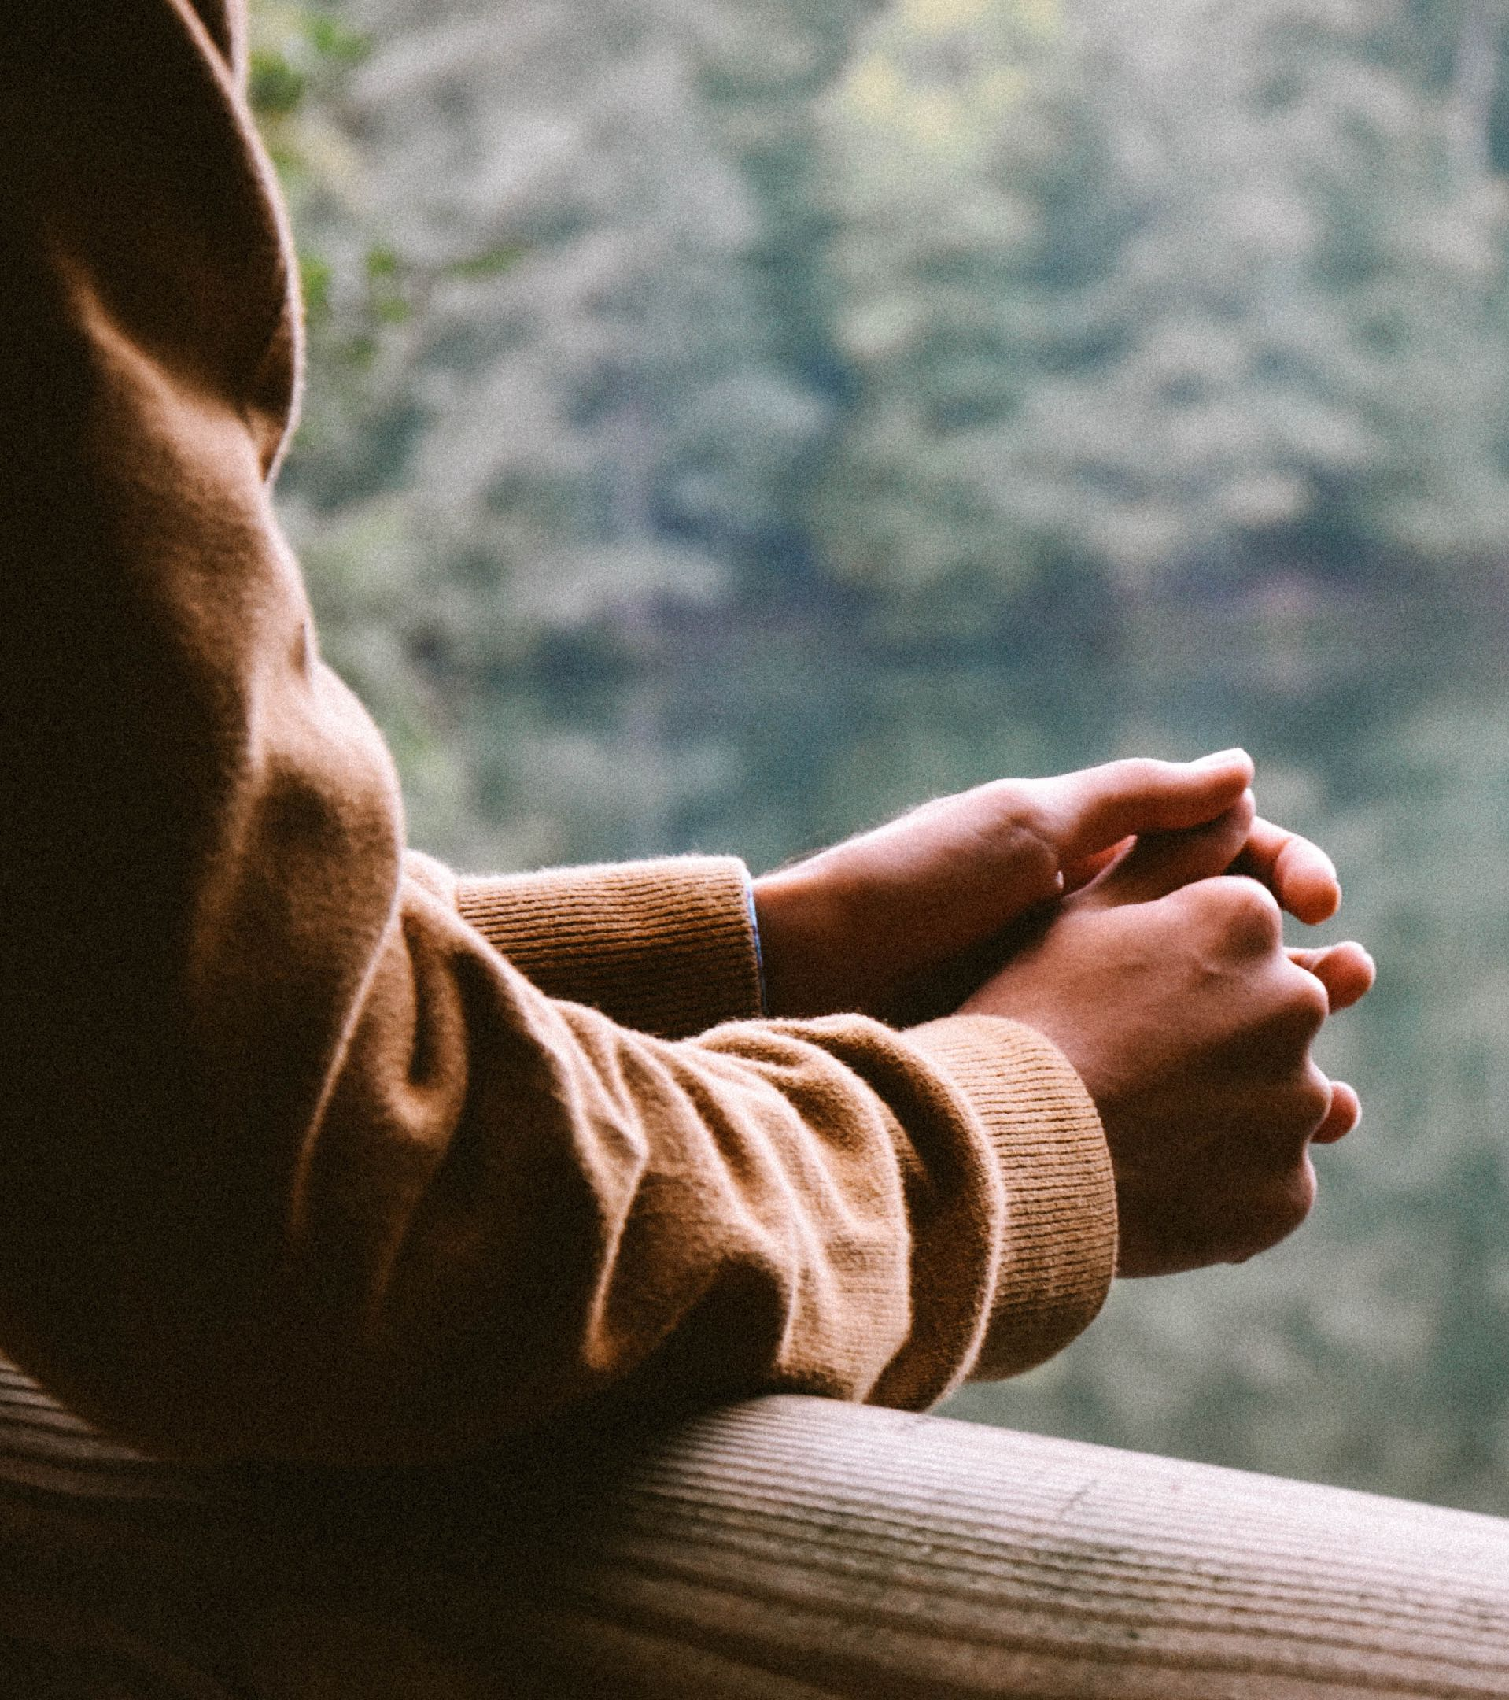
Every call your God will hear
Every cry and care

Slide 19
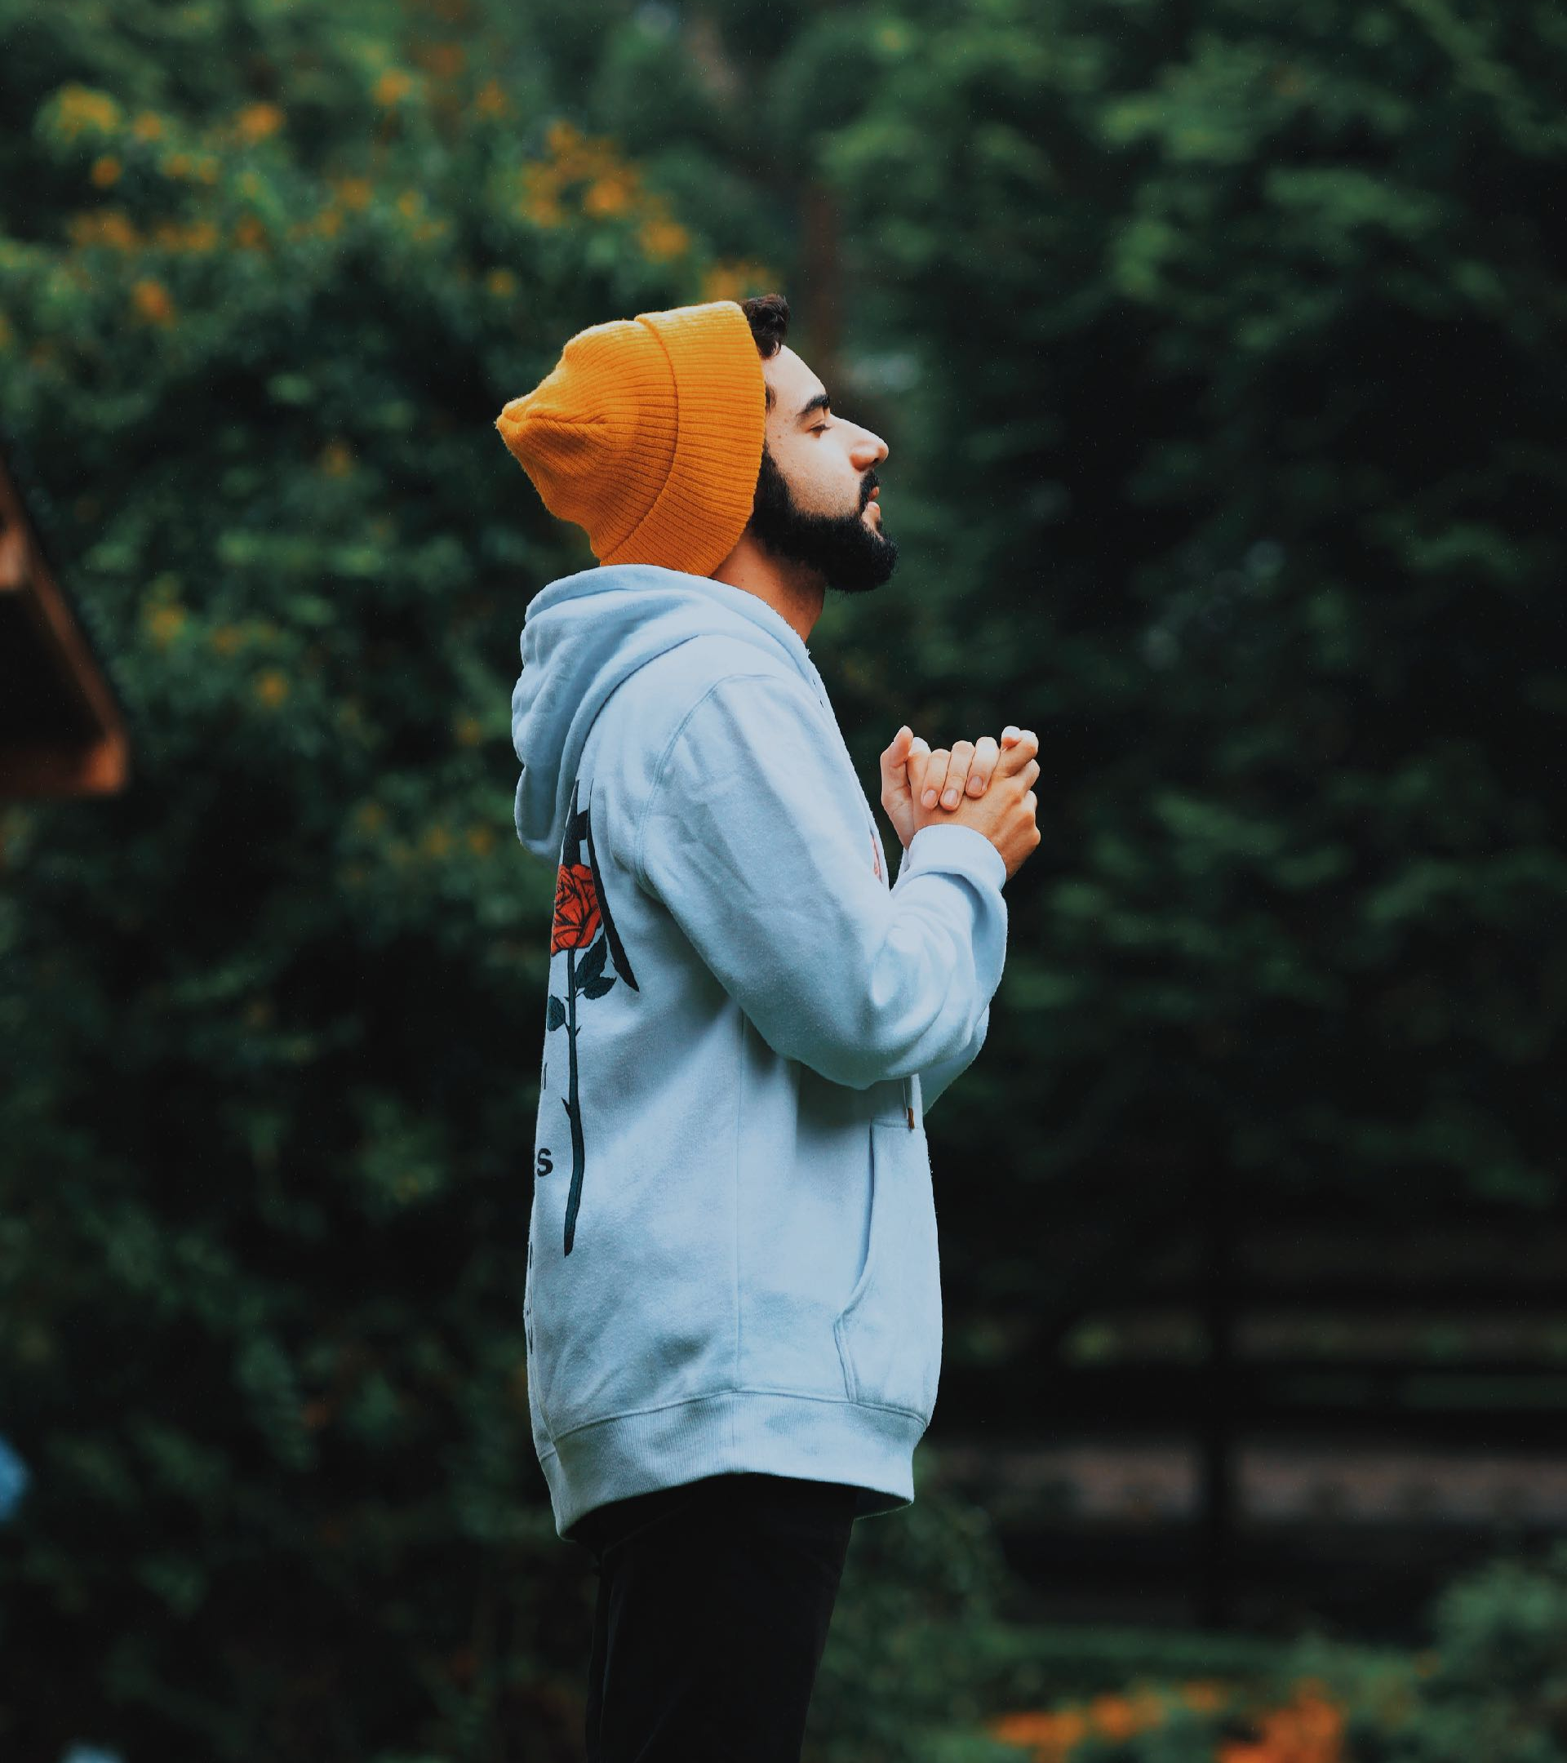
He will be the answer strong
To such a people’s prayer

Slide 20
The light is shining
The darkness flees

Slide 21
Give God the glory
’Til all can see

Slide 22
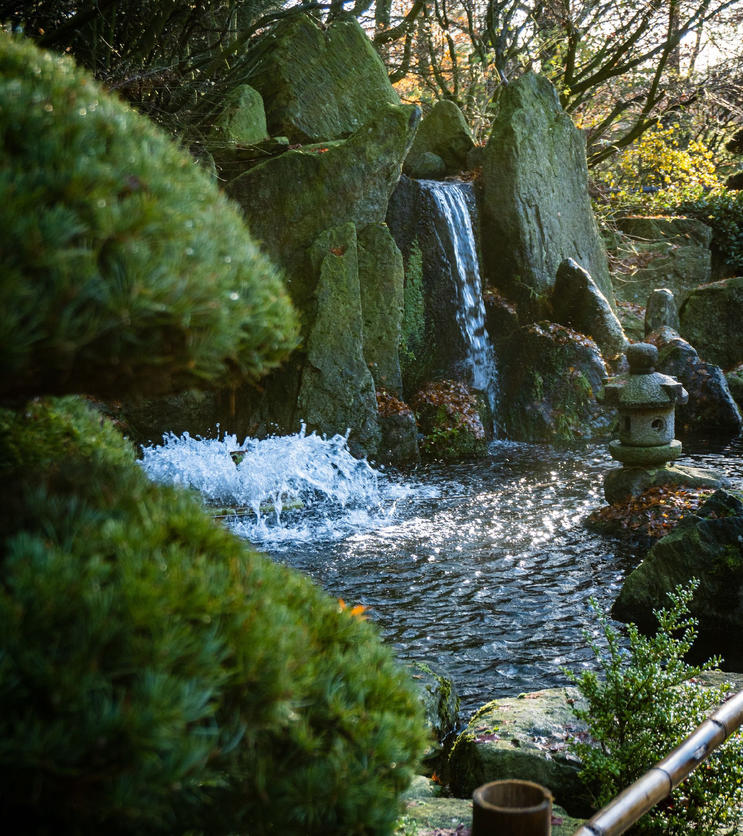
Like a watered garden green
From a bubbling stream
Like a watered garden green
From a bubbling stream

Slide 23
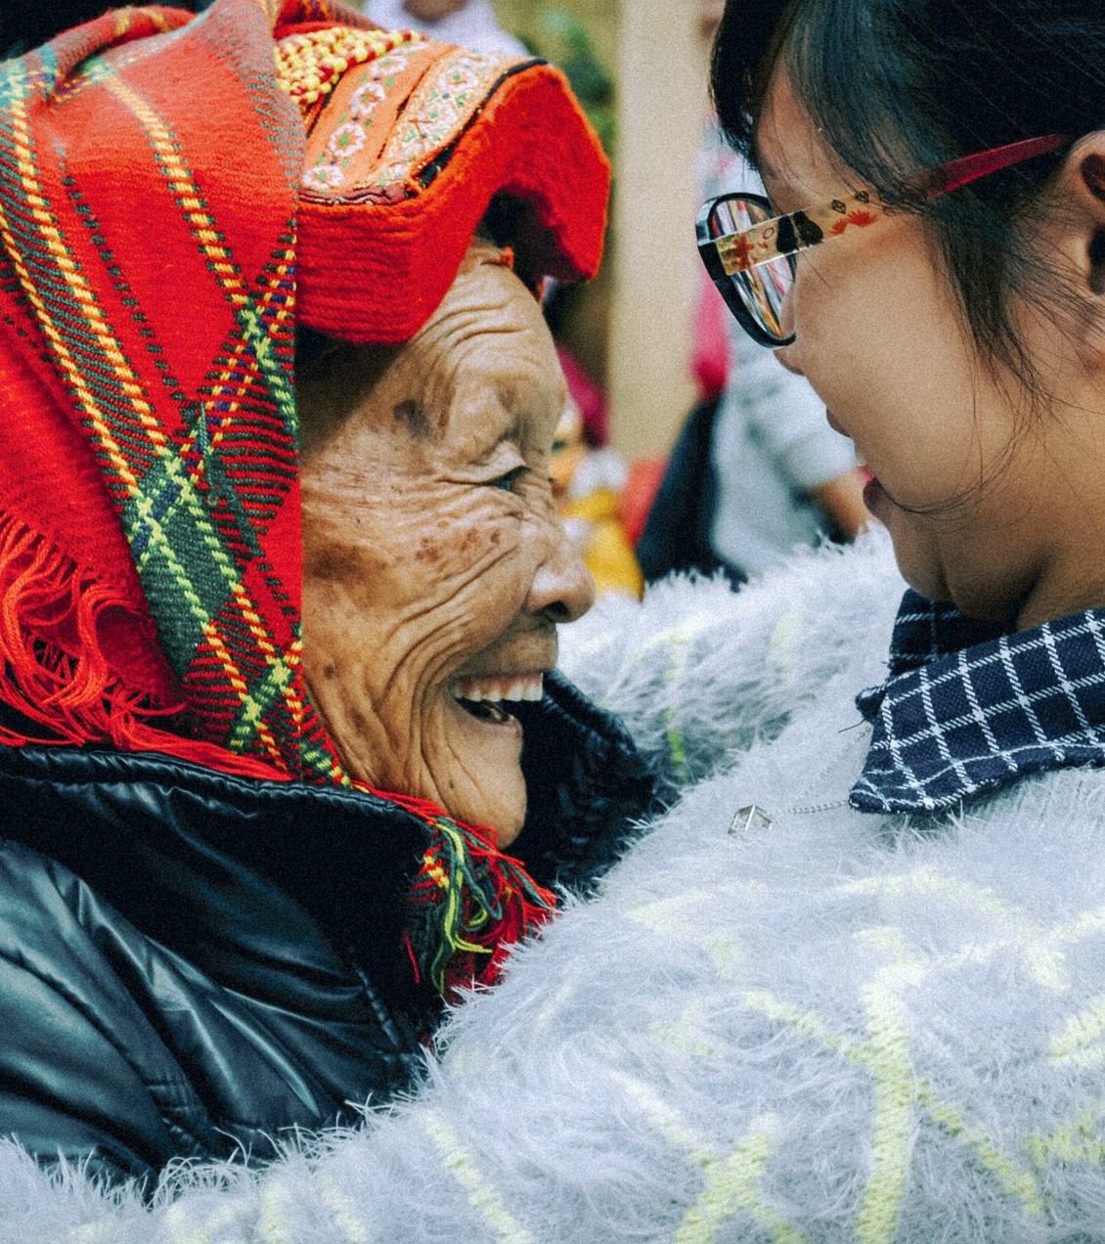
Joy and grace will spring from you
Flowing pure and clean

Slide 24
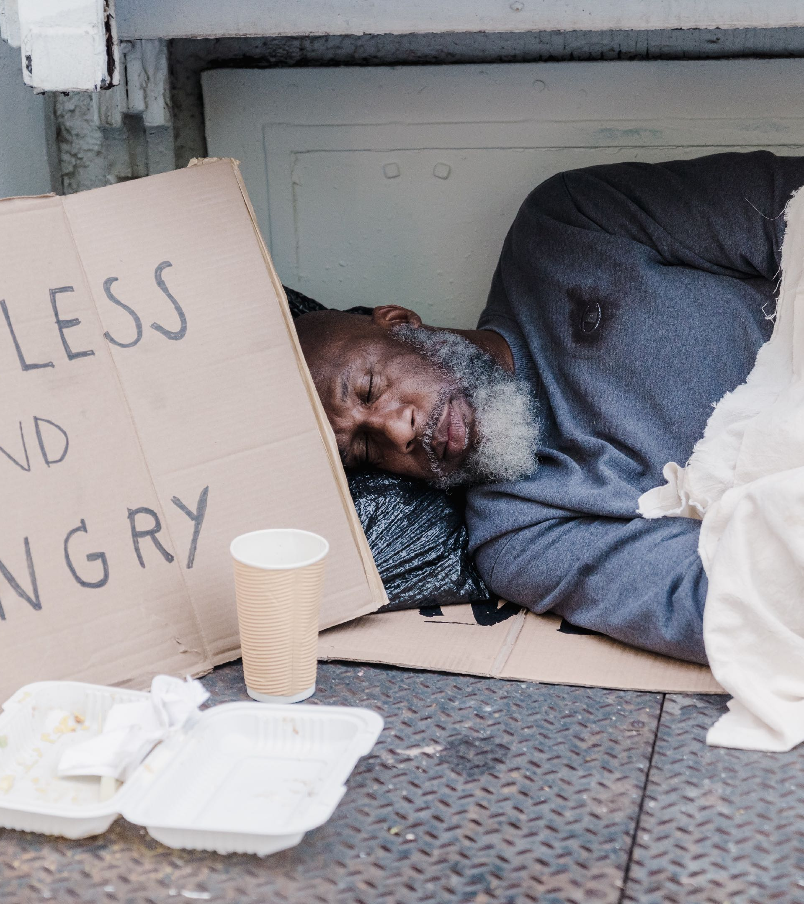
You will be a city safe
Where the poor can live

Slide 25

Safety, shelter they will find
In the love you give

Slide 26

God will guide you every step
Your soul will never thirst

Slide 27
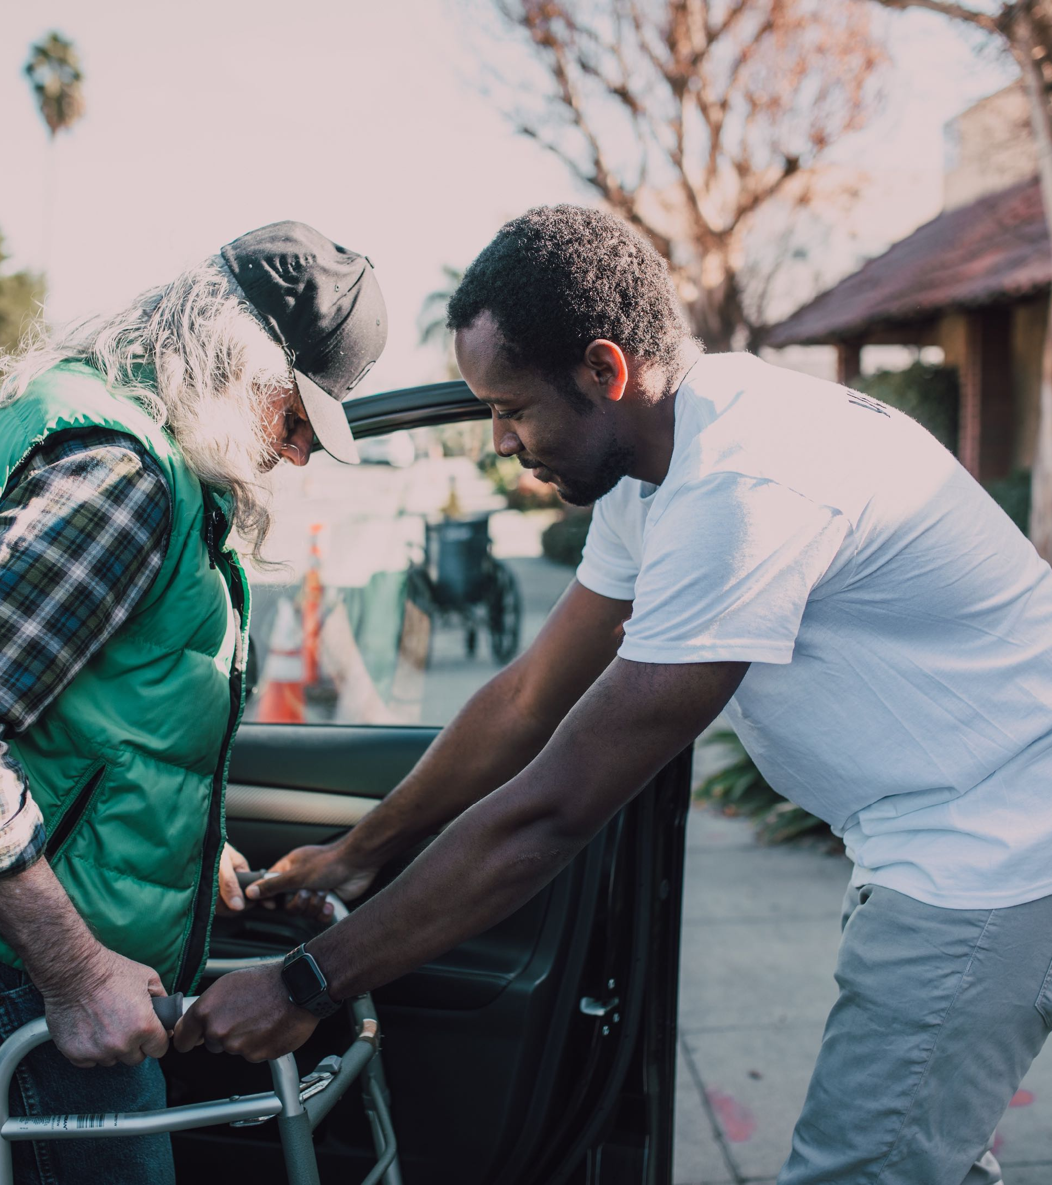
Since you served the broken ones
And put their healing first

Slide 28
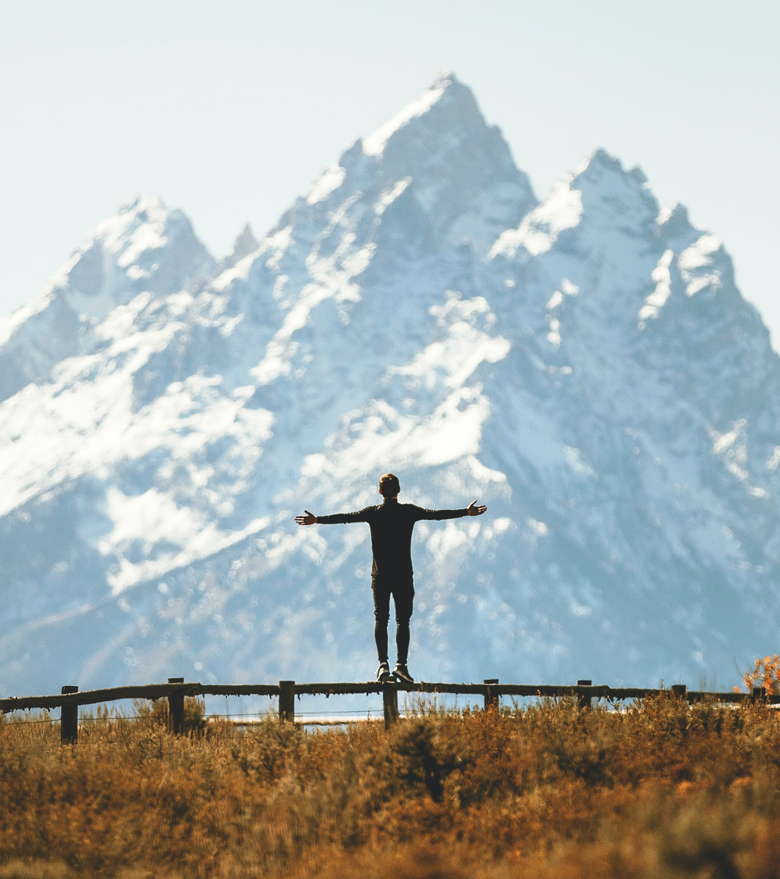
In God’s presence you’ll rejoice
He’ll be your delight

Slide 29

Sorrow, suffering chased away
Finally, no more night

Slide 30
The light is shining
The darkness flees

Slide 31
Give God the glory
’Til all can see

Slide 32
The light is shining
The darkness flees

Slide 33
Give God the glory
’Til all can see

Slide 34

Words and Music By Scott Griswold
Pictures from unsplash.com, pixels.com, pixabay.com

